Slide 1
HeuristicLab 4.0
Roadmap – Features – Improvements

Slide 2
HL 4.0 - Overview
Problem Development
Algorithm Development
New Persistence
Plugin Infrastructure Changes
Code Organization
Minor Changes

Slide 3
Roadmap
2 releases until HL 4.0
HL 3.3.14 “Unnamed”: March 2016
HL 3.3.15 “Denver”: July 2016 (before/at GECCO 2016)
HL 4.0
use summer for finishing 4.0
release in September 2016
present HL 4.0 at APCASE 2016 (?)
Between 3.3.15 and 4.0
integration of new HL 4.0 features into trunk
HL3legacy branch
last version of trunk before integration
will only get bugfixes
can be used until trunk settles

Slide 4
Problem Development
Over the course of HL 3.3 releases
two types of „problems“ emerged
(Single|Multi)ObjectiveHeuristicOptimizationProblem
Requires to discover and wire all operators, evaluators, etc.
(Single|Multi)ObjectiveBasicProblem
Uses encoding classes to do most of the discovery and wiring
Specifies basic methods (Evaluate, Analyze) in order to avoid writing new operators
two types of algorithms emerged
EngineAlgorithm
Requires modeling the algorithm as an operator graph
BasicAlgorithm
Describes the algorithm in terms of pure C# code
For instance, Brian‘s P3 algorithm is such a BasicAlgorithm

Slide 5
Shortcomings
Not all algorithms are compatible with both problem types
For instance, we cannot apply P3 on HeuristicOptimizationProblems
We also cannot apply P3 on all BasicProblems (e.g. programmable/external evaluation that make use of only the BinaryVectorEncoding)
Multiple ways of implementing a problem are confusing and BasicProblem is the more user-friendly approach
We do not have any semantic attachment to variables that are considered to encode a solution
For instance, generic operators, such as DiversityAnalyzers are cumbersome to implement

Slide 6
Individual will be replaced
HeuristicLab 3.3
HeuristicLab 4.0
public class CompiledSingleObjectiveProblemDefinition : CompiledProblemDefinition, ISingleObjectiveProblemDefinition { public bool Maximization { get { return false; } } public override void Initialize() { Encoding = new RealVectorEncoding("r", length: 5, min: -1.0, max: 1.0); } public double Evaluate(Individual individual, IRandom random) { var quality = 0.0; quality = individual.RealVector("r").Sum(x => x * x); return quality; } public void Analyze(Individual[] individuals, double[] qualities, ResultCollection results, IRandom random) { } public IEnumerable<Individual> GetNeighbors(Individual individual, IRandom random) { while (true) { var neighbor = individual.Copy(); var index = random.Next(neighbor.RealVector("r").Length); neighbor.RealVector("r")[index] += 2 * random.NextDouble() - 1; yield return neighbor; } } }
public class CompiledSingleObjectiveProblemDefinition : CompiledSingleObjectiveProblemDefinition<RealVectorEncoding, RealVector> { public override bool Maximization { get { return false; } } public override void Initialize() { } public override double Evaluate(RealVector solution, IRandom random) { var quality = 0.0; quality = solution.Sum(x => x * x); return quality; } public override void Analyze(RealVector[] solutions, double[] qualities, ResultCollection results, IRandom random) { } public override IEnumerable<RealVector> GetNeighbors(RealVector solution, IRandom random) { while (true) { var neighbor = (RealVector)solution.Clone(); var index = random.Next(neighbor.Length); neighbor[index] += 2 * random.NextDouble() - 1; yield return neighbor; } } }

Slide 7
Open Points
Programmable Encodings?
If you want to quickly test an idea for a new crossover you have to temporarily add the code to an existing plugin or create a new plugin
Analyzers for BasicAlgorithms
BasicAlgorithms do not use Scopes for storing solutions, they cannot currently be studied using existing Analyzers
Multiple Encodings per Solution
For instance, Permutation + EdgeRepresentationEncoding, Permutation + PositionRepresentationEncoding with selected operators
TSP would be implemented with EdgeRepresentationEncoding (-> no CX, CX2 anymore)
QAP would be implemented with PositionRepresentationEncoding (-> no ERX anymore)

Slide 8
Pause for BasicAlgorithms
BasicAlgorithms allow to easily create new algorithms
P3 (Parameter-less Population Pyramid) was implemented within one week
Override Initialize(…) to initialize the algorithm
Implement Run(…) so that it supports pause/resume
Up to now, BasicAlgorithms could not be paused
BasicAlgorithms.Pausable has been added
If true, cancelling the CancellationToken can pause the algorithm
Specific algorithm is responsible for supporting pause/resume
protected override void Initialize(CancellationToken cancellationToken) { Results.Add(new Result(BestQualityResultName, new DoubleValue(double.NaN))); Results.Add(new Result(IterationsResultName, new IntValue(0))); base.Initialize(cancellationToken); } protected override void Run(CancellationToken cancellationToken) { while (ResultsIterations < Iterations) { cancellationToken.ThrowIfCancellationRequested(); // execute one iteration ResultsIterations++; } }

Slide 9
Async Start/Stop for Algorithms
We should better reflect the style of async/wait programming in C#
IExecutable.Start is actually an asynchronous operation and should be named StartAsync
Sample tests (and e.g. scripts) must use helper functions to wait for algorithm results
We could just call Start synchronously
We added/implemented IExecutable.Start and IExecutable.StartAsync
var ga = new GeneticAlgorithm() // configure algorithm ... ga.Start() // start "synchronously" (calls StartAsync().Wait()) ga.StartAsync() // start asynchronously ga.StartAsync().Wait() // start asynchronously and wait

Slide 10
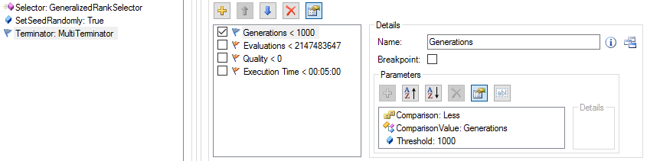
New Termination Criteria (JKarder/MKommend/PFleck)
Allows consistent termination in all EngineAlgorithms
Additional concept to better compare algorithm performances
e.g. only allow 10⁶ evaluations for each algorithm
TerminationOperator uses MultiTerminator and cancels the algorithm if any of the active termination criteria is not met

Slide 11
New Persistence
Motivation
Performance
Speed, file size, memory consumption
More flexibility
Backwards compatibility
Renaming of classes
Versioning
Technical
Google Protocol Buffers instead of XML
Independence of type names
Caching
Storage format, API: In development

Slide 12
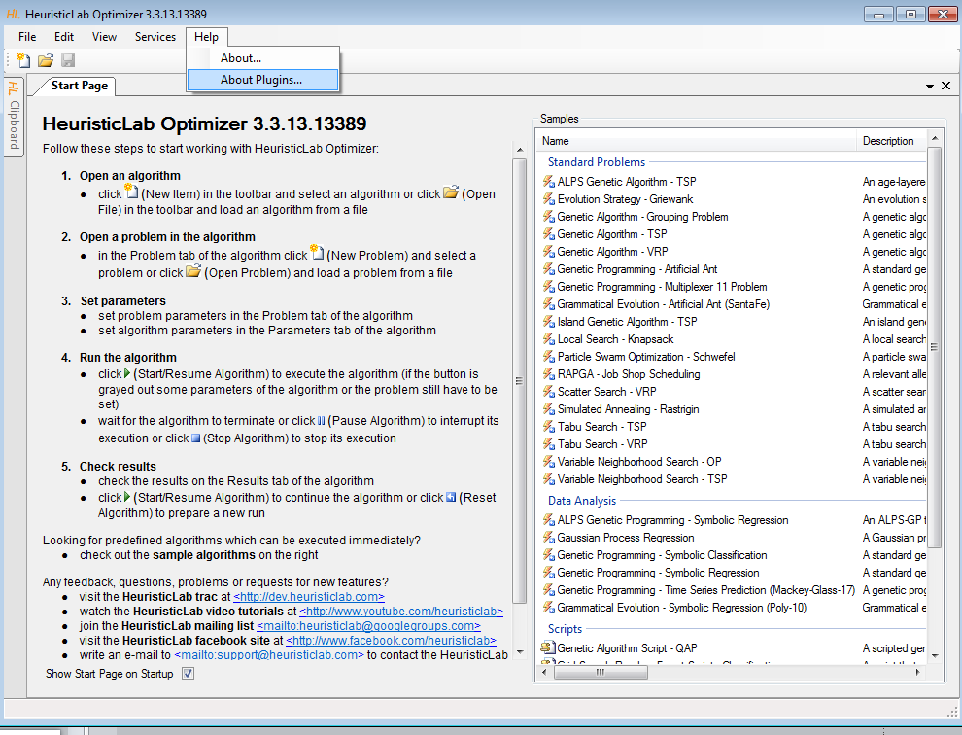

Slide 13
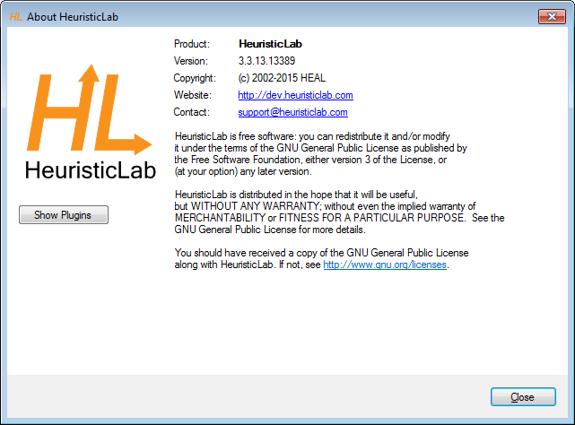

Slide 14
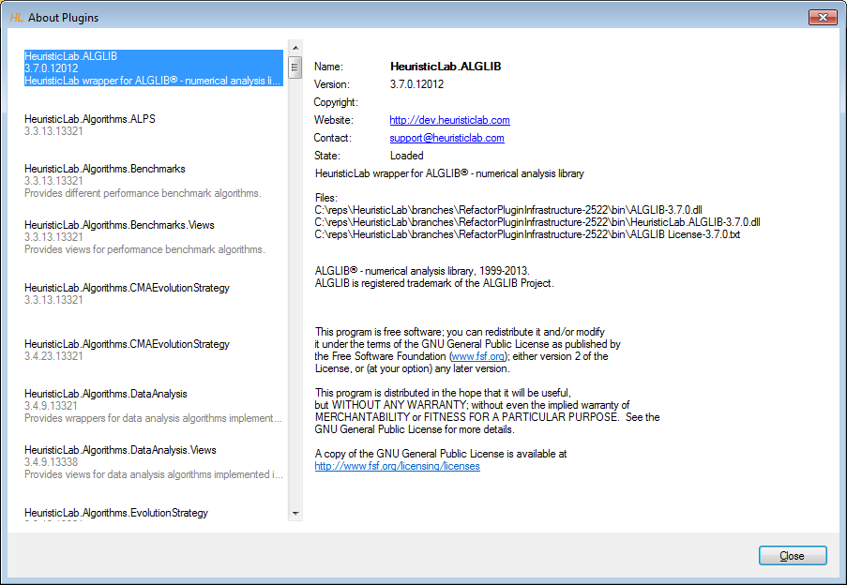

Slide 15
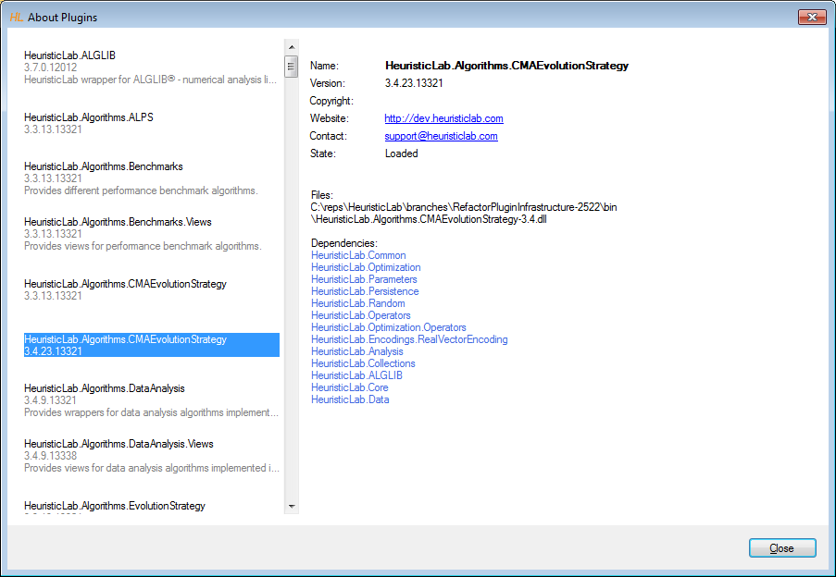

Slide 16
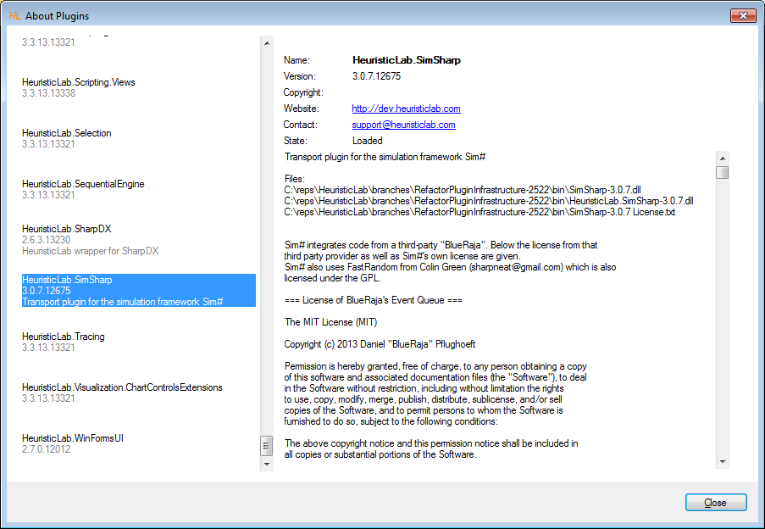

Slide 17
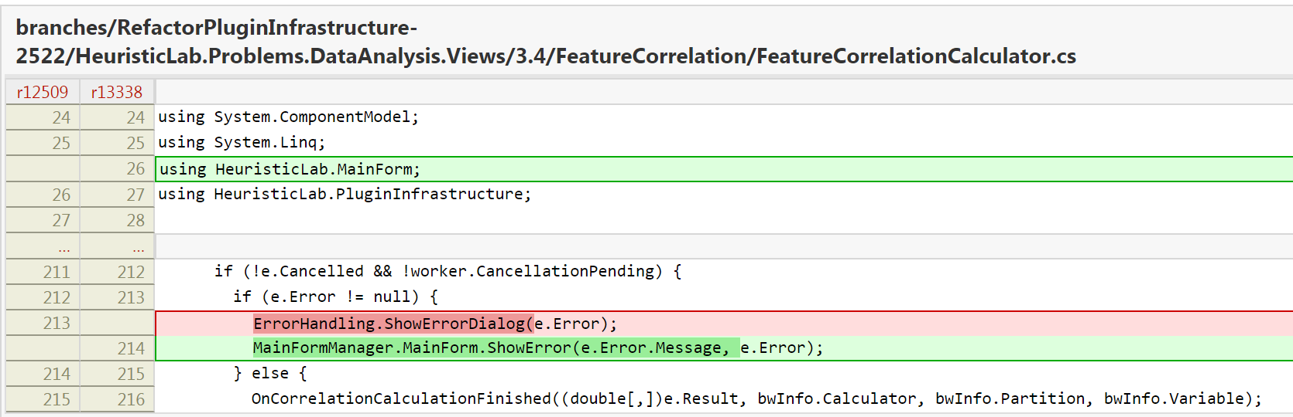
ErrorHandling über MainForm statt über PluginInfrastucture (für Views)

Slide 18
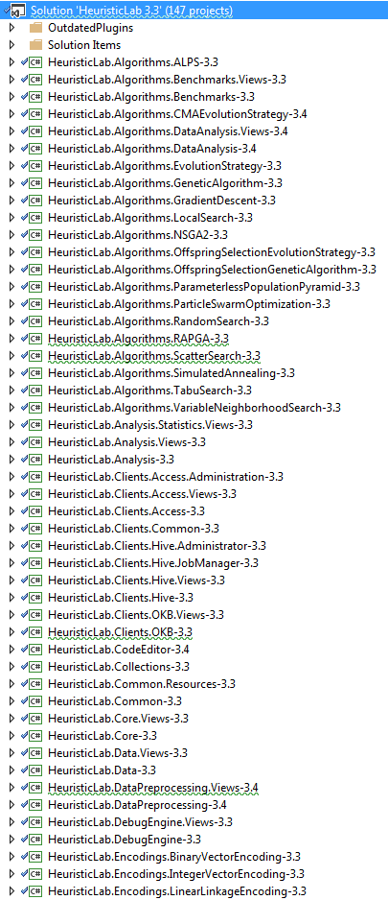
HeuristicLab Code Organization
Trunk solution contains 147 projects !!!
Fewer assemblies / plugins
15 projects
Separation between Content & Views
Faster build times
No frame files
No dependency to SVN (SubWCRef)
File Location = Namespace
Assemblies are not signed
Easier to profile

Slide 19
Minor Changes
Refactoring of CollectionEvents (error prone)
New Parameters:
ResultParameters
ProblemParameters
AlgorithmParameters
Repository Layout
Easier Branching

